Slide 1
Investigation of Nitrogen Molecular Dynamics and Reaction Kinetics in an Industrial Ozone Generator
PI: Daniel E. Guerrero
Research Collaborators: Dr. Alfred Freilich,
Dr. Stephen Kelty & Dr. Jose L. Lopez

Slide 2
Outline
Introduction to Ozone Generation
The Role of Nitrogen
Preliminary Experiments
Future Work
Conclusion

Slide 3
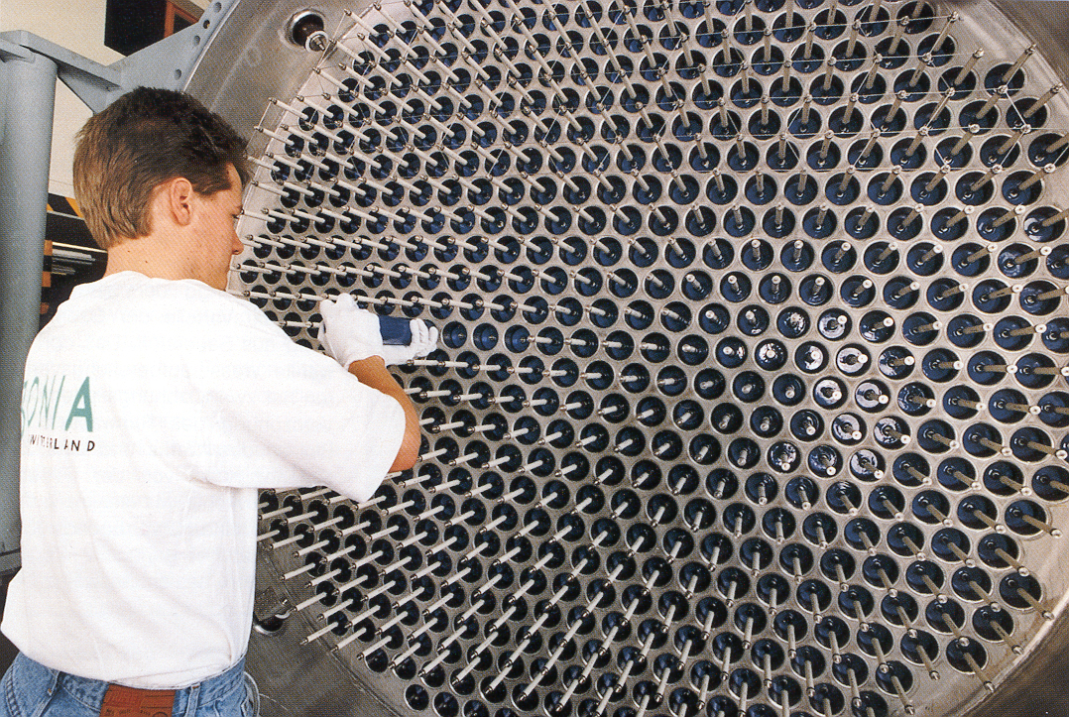
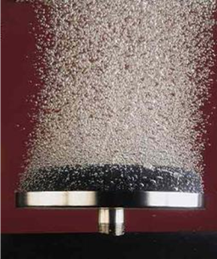
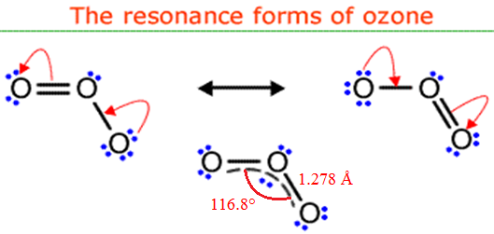
What is Ozone?
Tri-atomic form of oxygen.
Most powerful commercial oxidizing agent available (E⁰ = +2.07V).
Unstable - must be generated and used onsite.
Leaves a dissolved residual which ultimately converts back to oxygen.
Relatively easy to manufacture.
Figure 2. Industrial ozone generator for water treatment.
Figure 1. The ‘averaged’ structure of ozone showing the delocalized molecular orbital.
Figure 3. Ozone disinfection bubble diffusers.

Slide 4
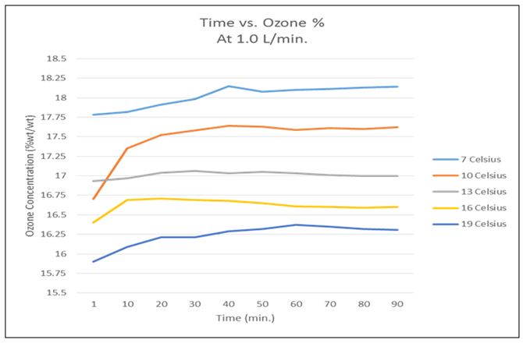
Generation of Ozone
Dielectric Barrier Discharge (DBD)
e- + O₂ → O₂* + e- (2) O₂* + O₂ → O₃* + O (2a) e- + O₂ → 2O + e- (3) O + O₂ → O₃* (3a) O₃* + M → O₃ + M* (4)
HV PSU
Dielectric
HV Electrode
O₂
O₂
O₂
O– –
e–
O– –
O₂
O₃
O₃
O₃+ O₂
O₂
e–
O₂
O₂
O₃
O₂
O₂
Heat
Heat
Ground Electrode
Figure 5. Water-cooled reactor with pure O₂ at 1.1 bar pressure and constant input power of 160 Watts.
Figure 4. Ozone generator diagram.
3 O₂ 2 O₃

Slide 5
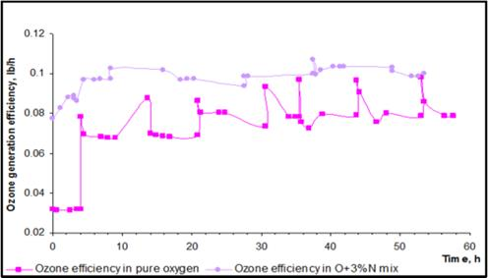
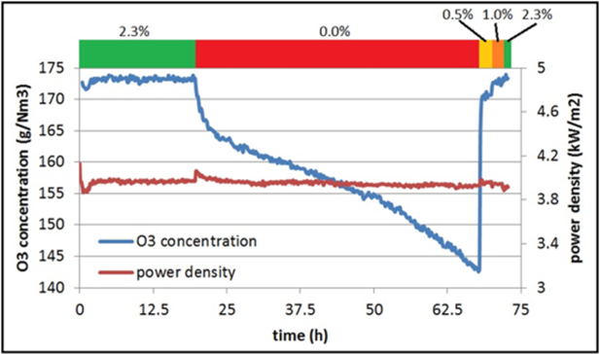
Why Use Nitrogen?
Figure 6. Plot of ozone production as a function of time with and without N₂.
Figure 7. Plot of ozone production efficiency as a function of N₂ inclusion at constant power density and temperature

Slide 6
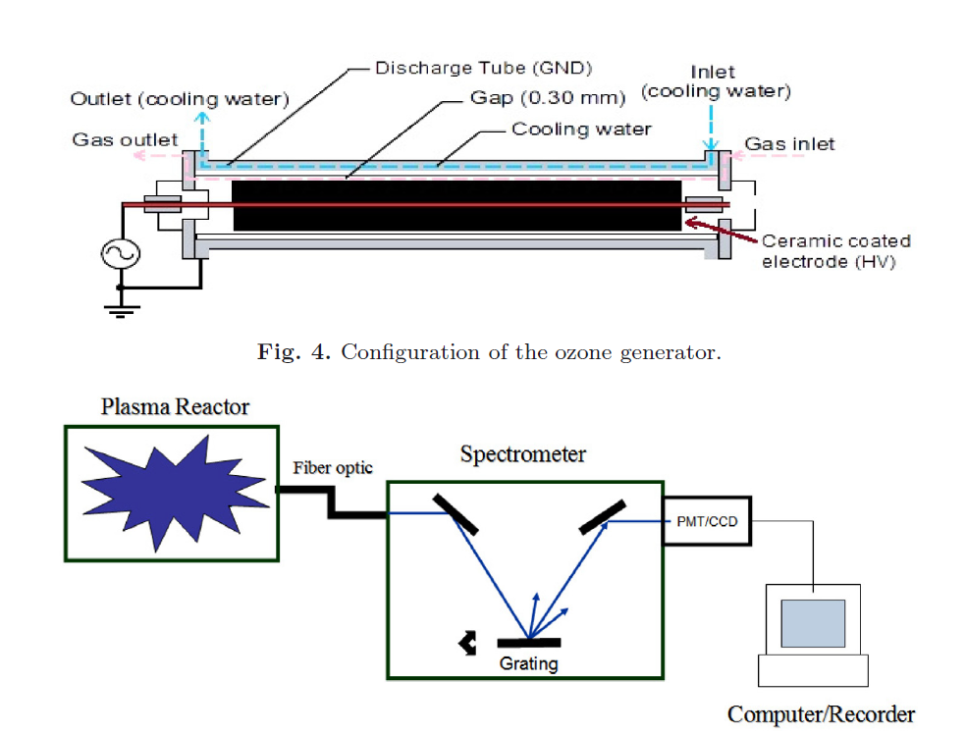
Plasma Temp. Study – Setup 1

Slide 7
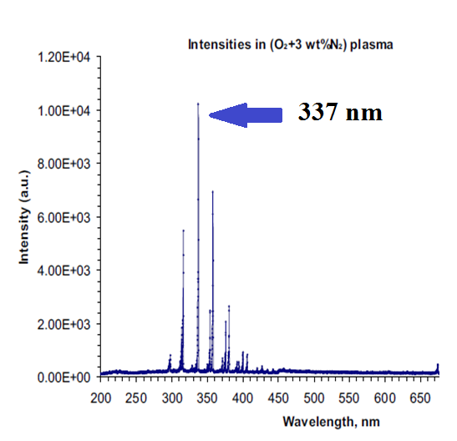
UV Emission Spectra – Setup 1
Figure 3 shows relative emission intensities from a DBD ozone generator with a feed gas mixture of (O₂ + 3% N₂) at 2.2 bar pressure.
*
*

Slide 8
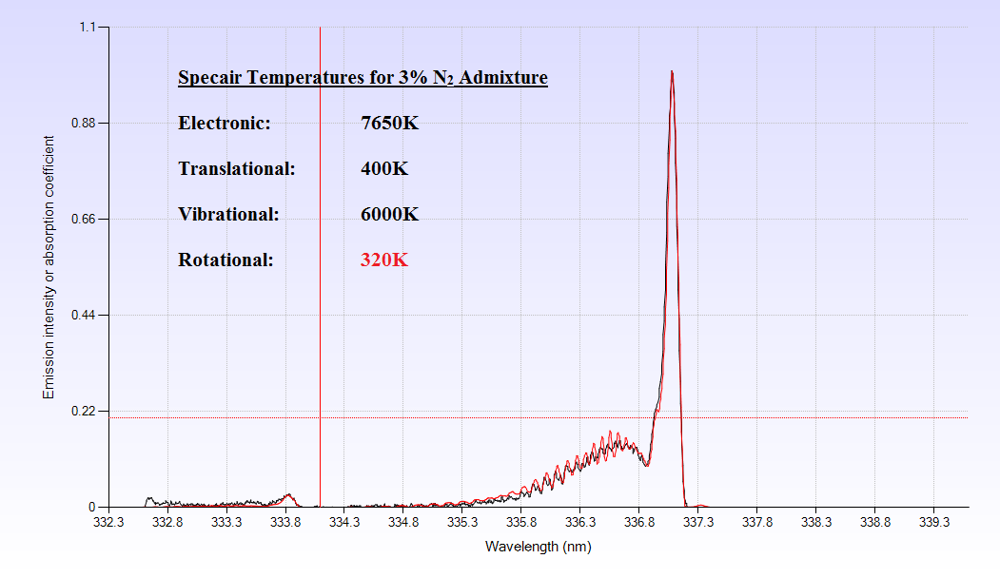
Preliminary Results – Setup 1

Slide 9
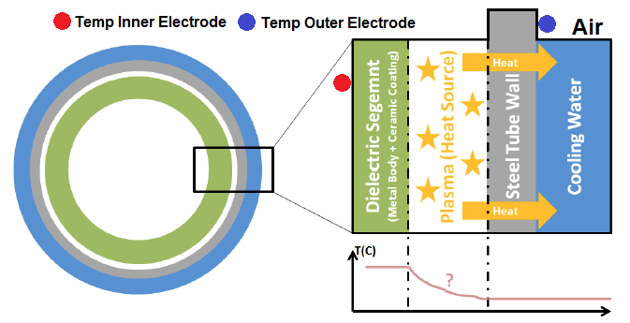
Preliminary Results – Setup 2
Recorded Temperature:
45.5 Degrees Celsius
~319 Kelvin

Slide 10
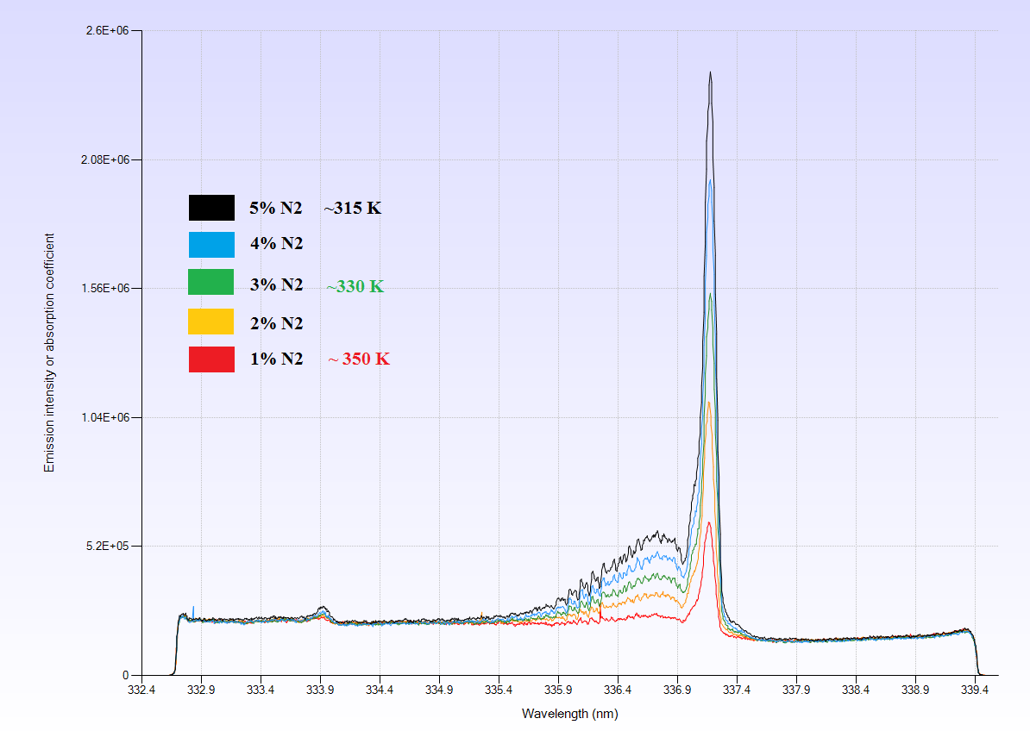
Effect of N₂ Conc. on Gas Temp.

Slide 11
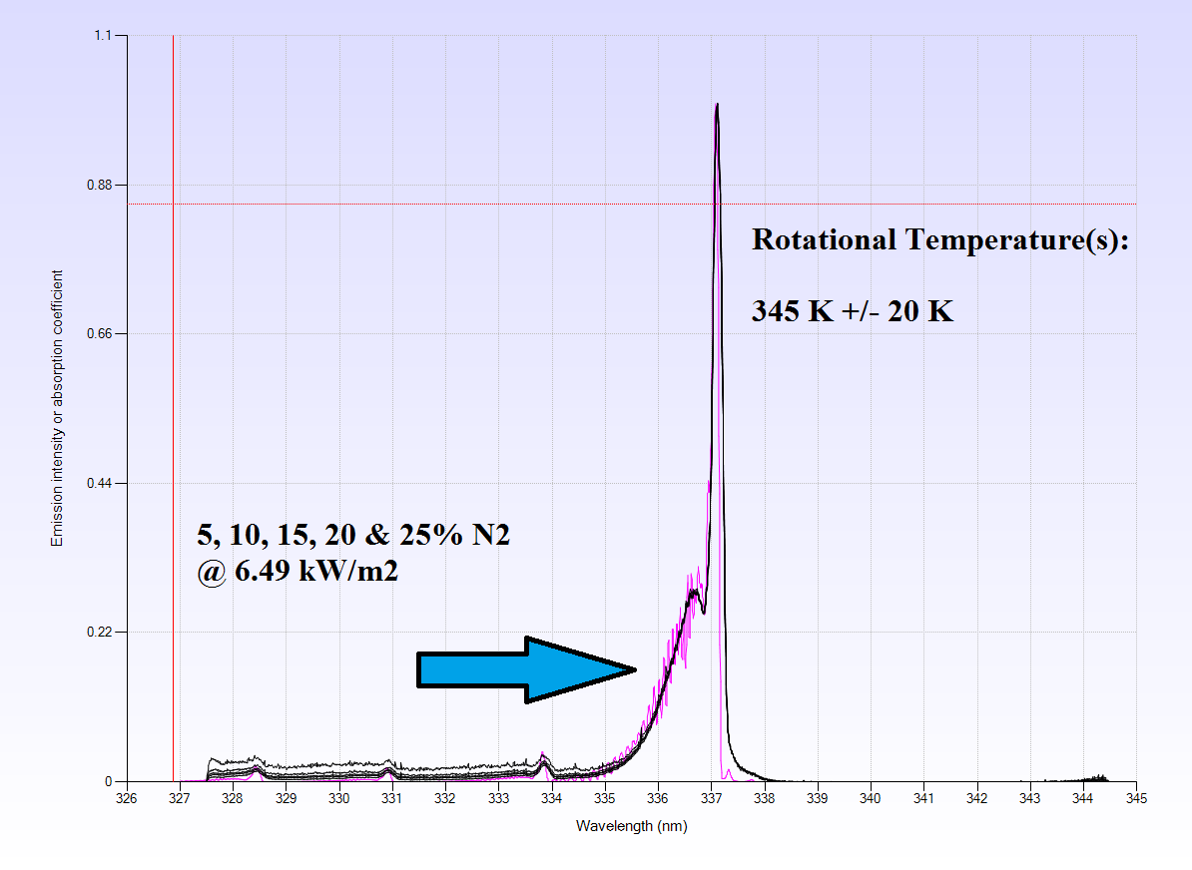
Effect of N₂ on Gas Temp. Cont.

Slide 12
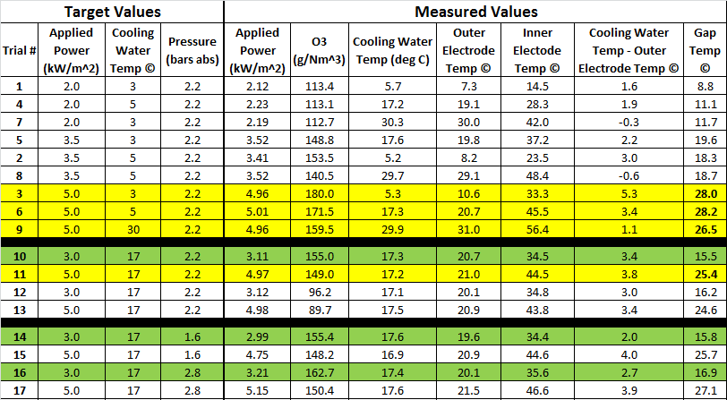
H₂O Temp and Pressure Effects

Slide 13
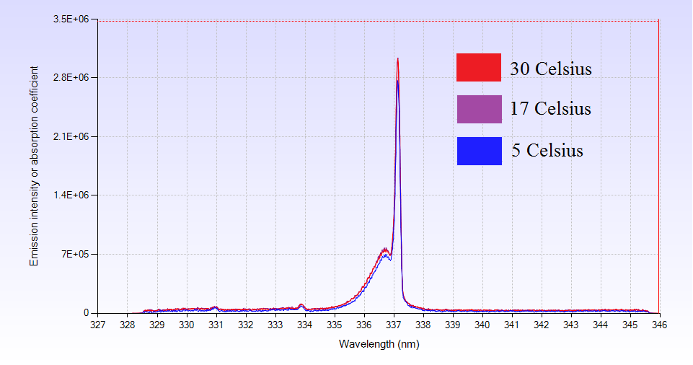
H₂O Temp Effect

Slide 14
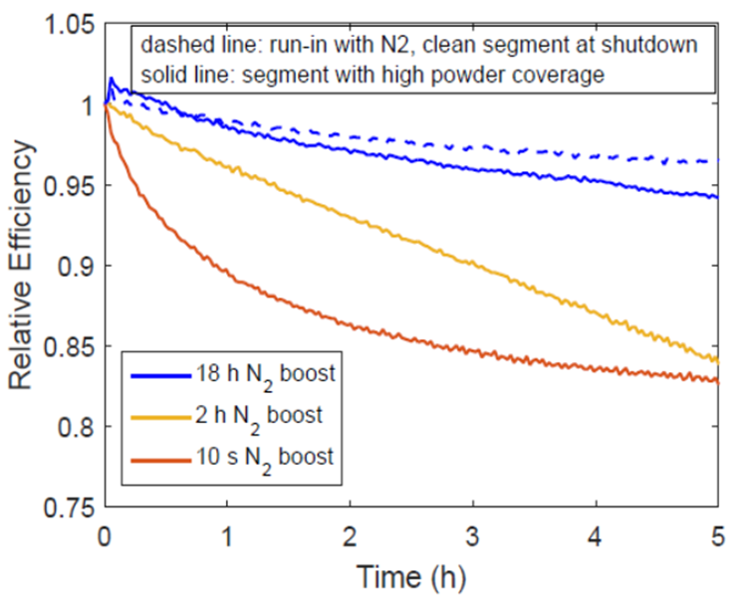
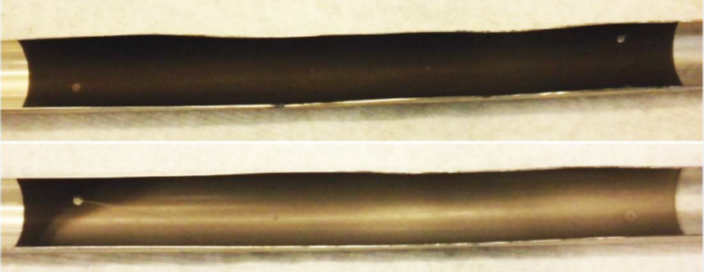
Working Hypothesis: Surface Effect
Figure 8. Time dependent evolution of ozone generation efficiency after shutdown of N₂ supply. During the experiments illustrated with solid lines, the high voltage electrode was already covered in a powder because of prior N₂-free operation. The dashed line corresponds to N₂ shutdown initiated with no prior N₂-free operation, i.e. a relatively powder-free electrode.
Figure 9. Photograph of the discharge tube when operated without N₂ (top) and with 2.3% N₂ (bottom).

Slide 15
Gas Effluent After N₂ Shutoff
Figure 10. FT-IR plot of reaction chamber effluent as a function of time following N₂ shutoff in the feed gas.

Slide 16
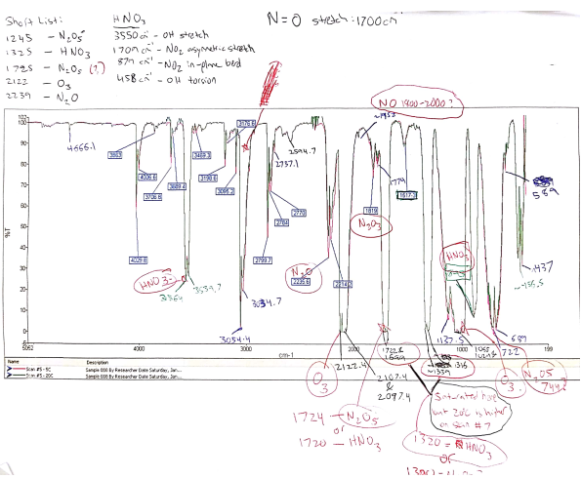
Gas Effluent After N₂ Shutoff

Slide 17
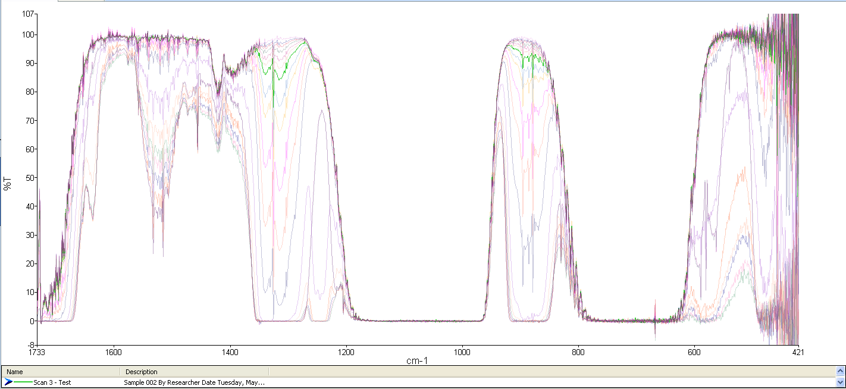
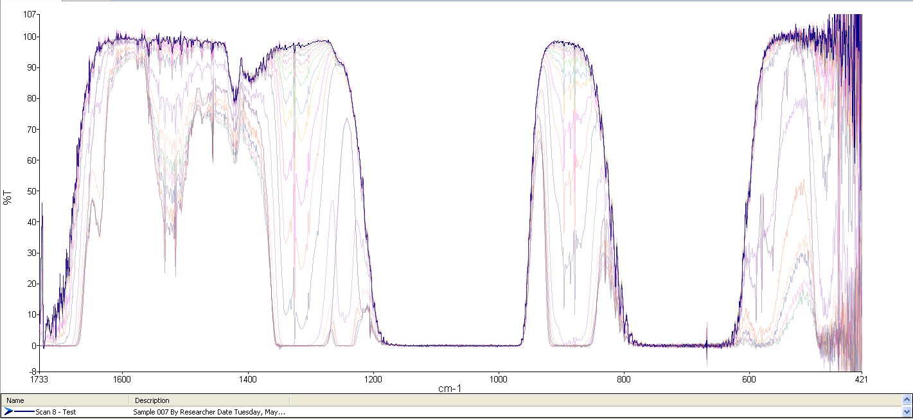
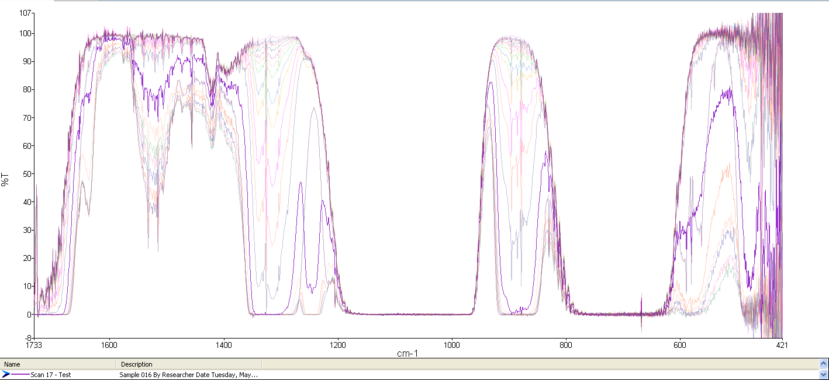
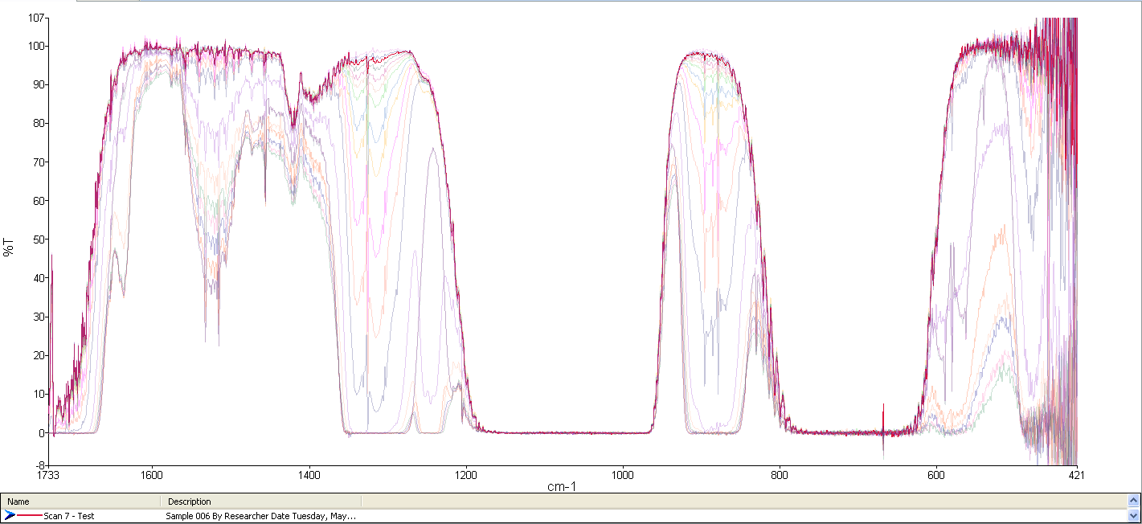
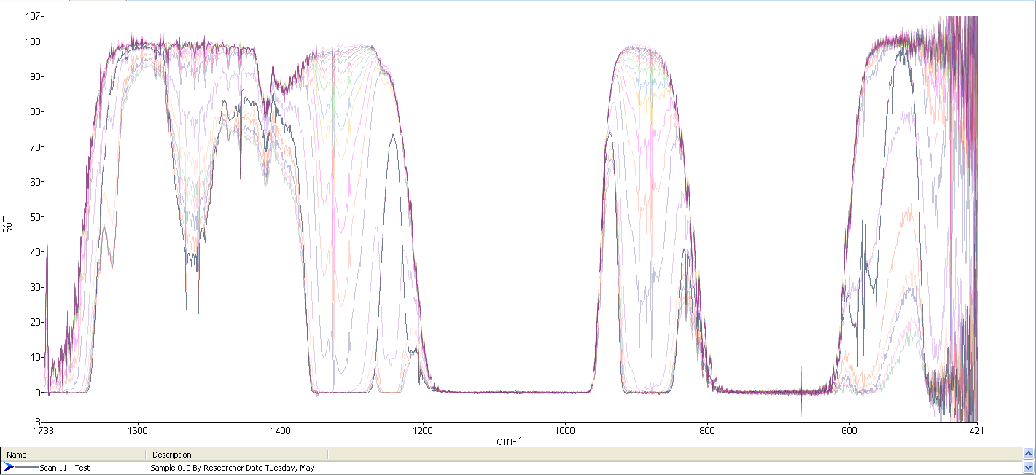
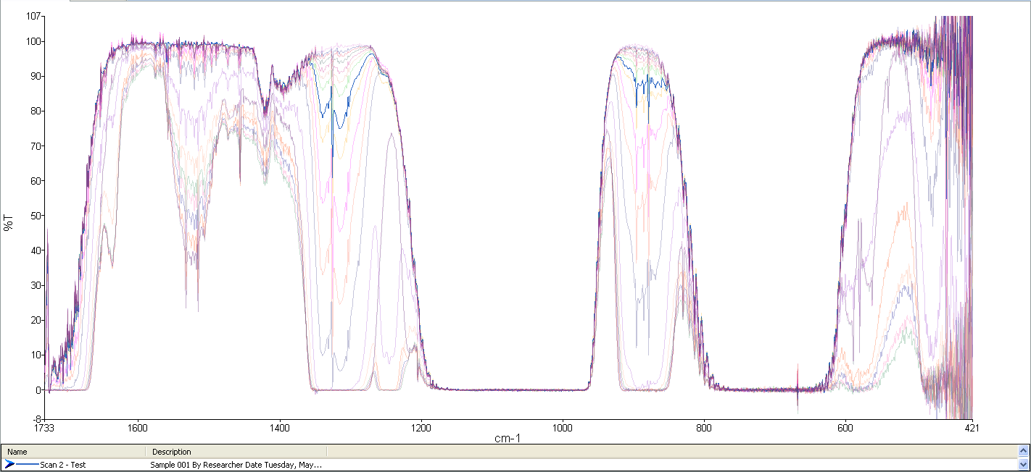
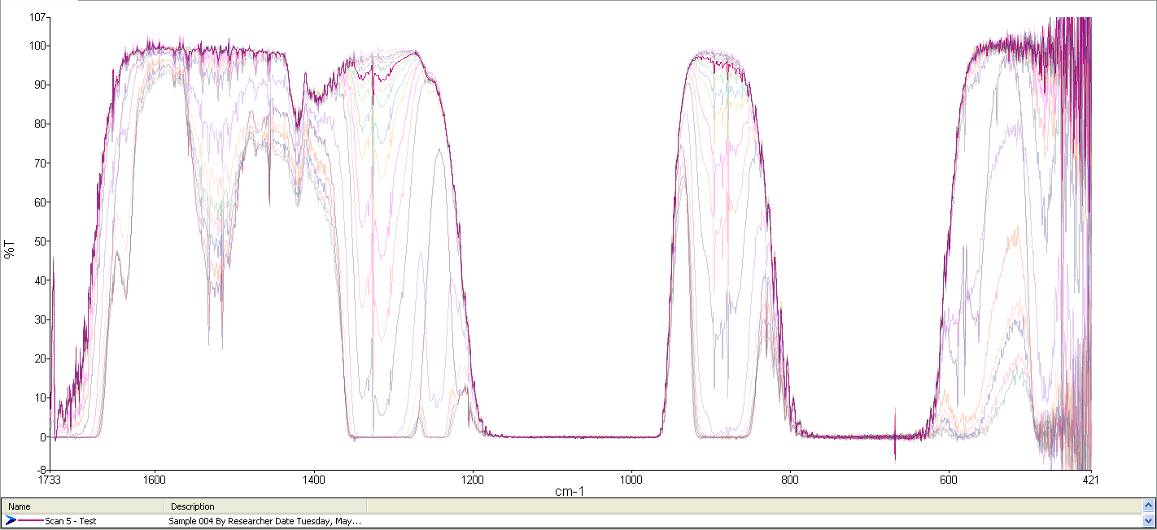
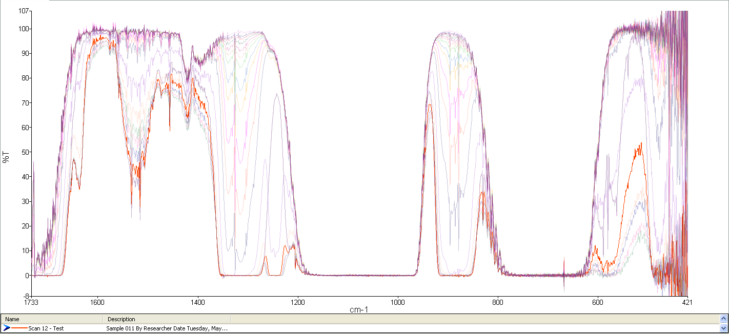
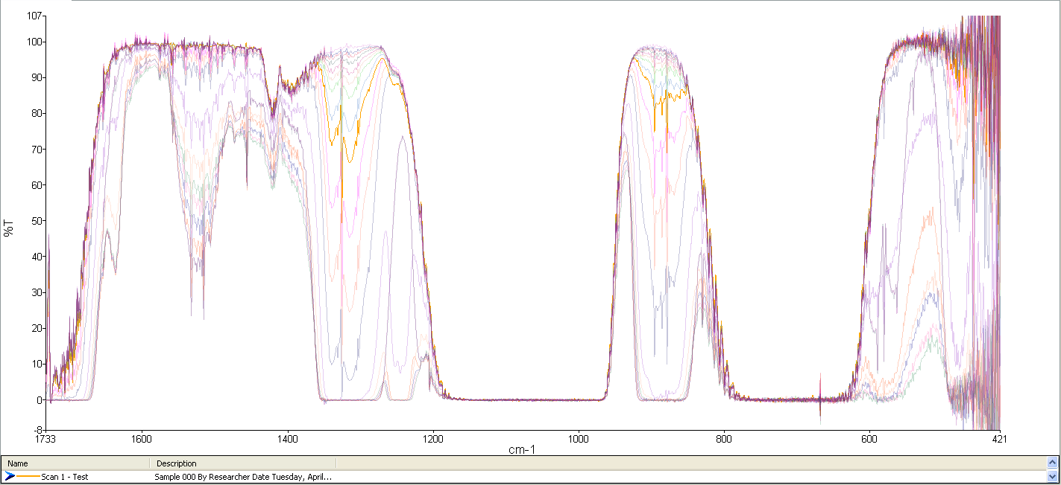
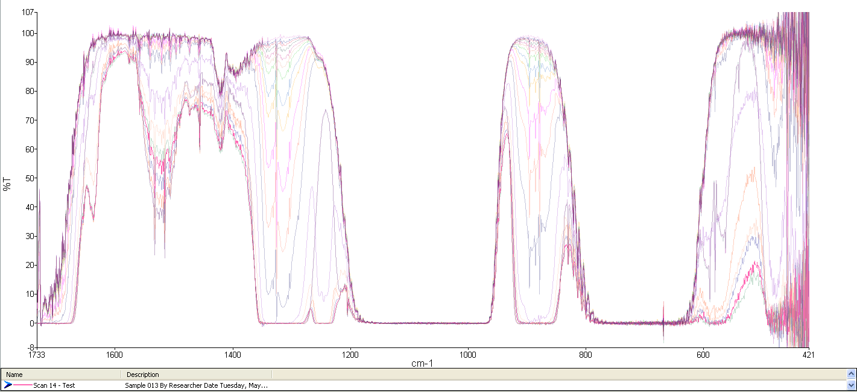
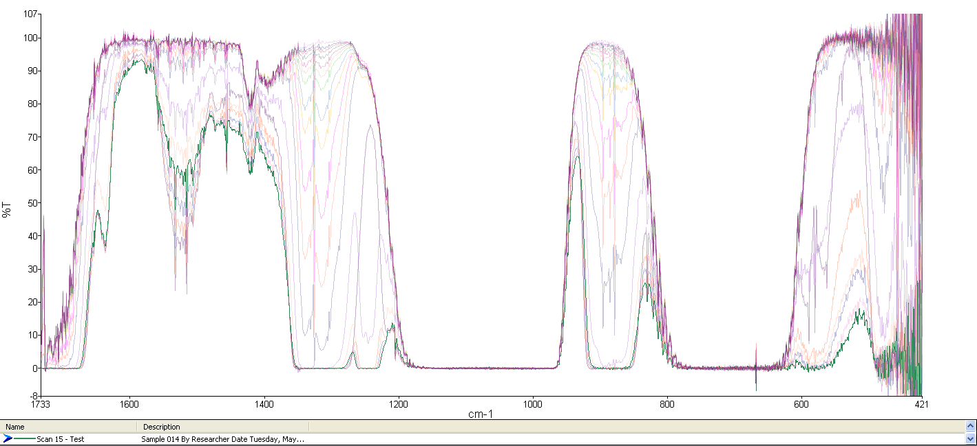
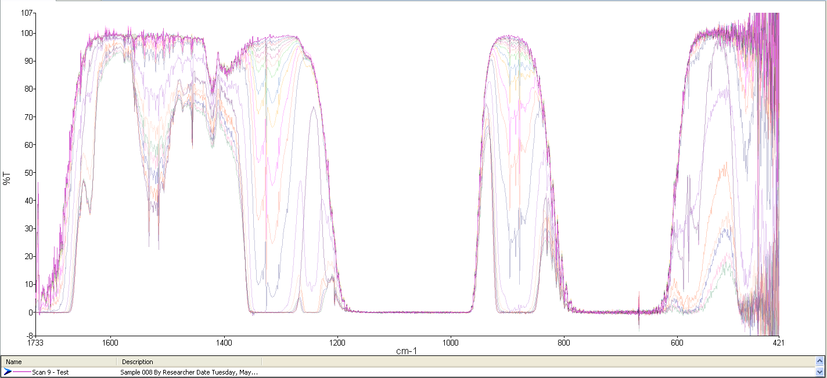
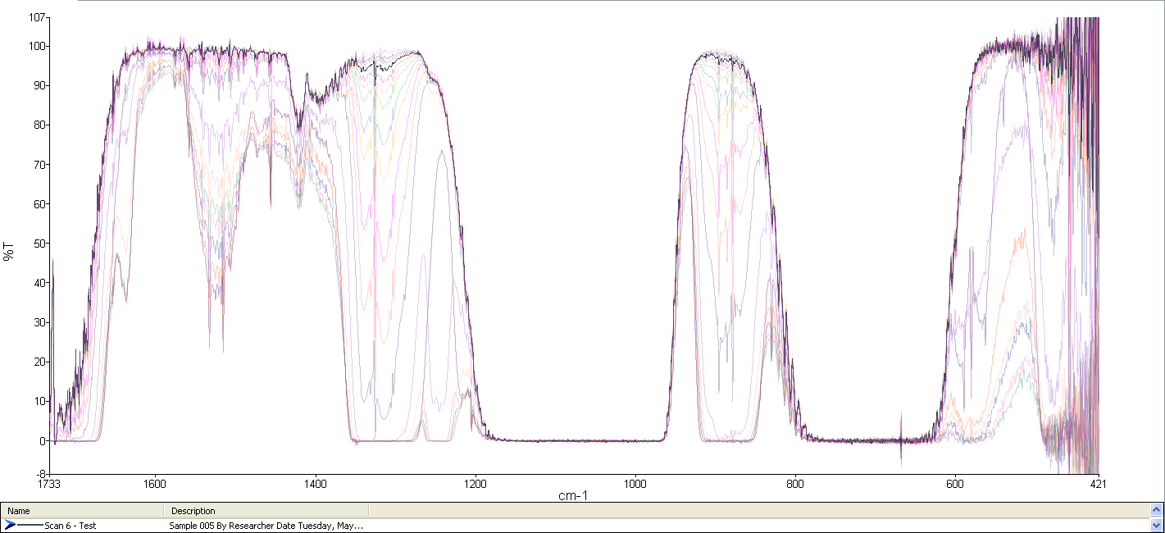
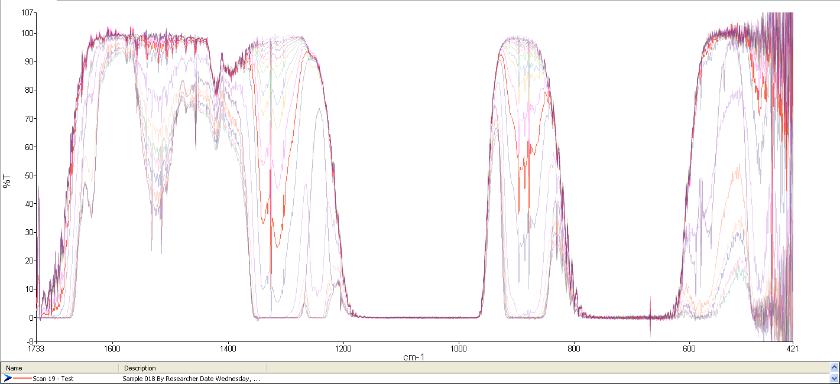
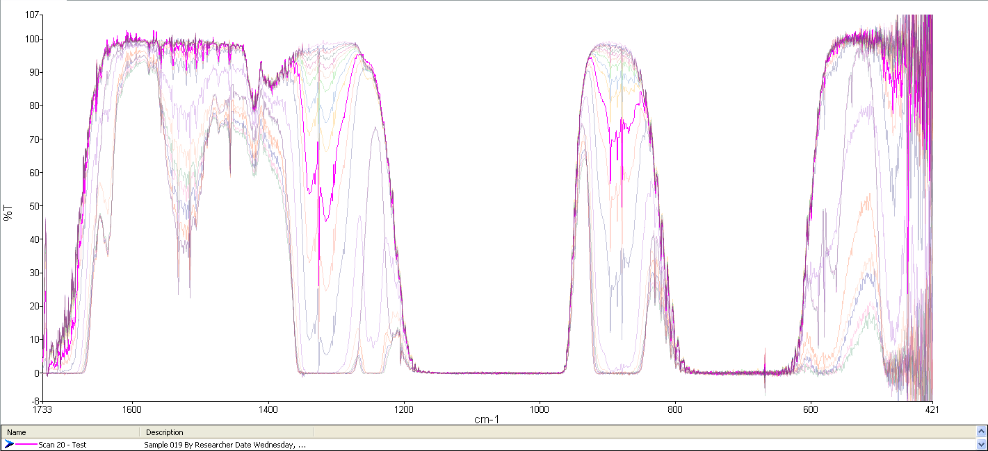
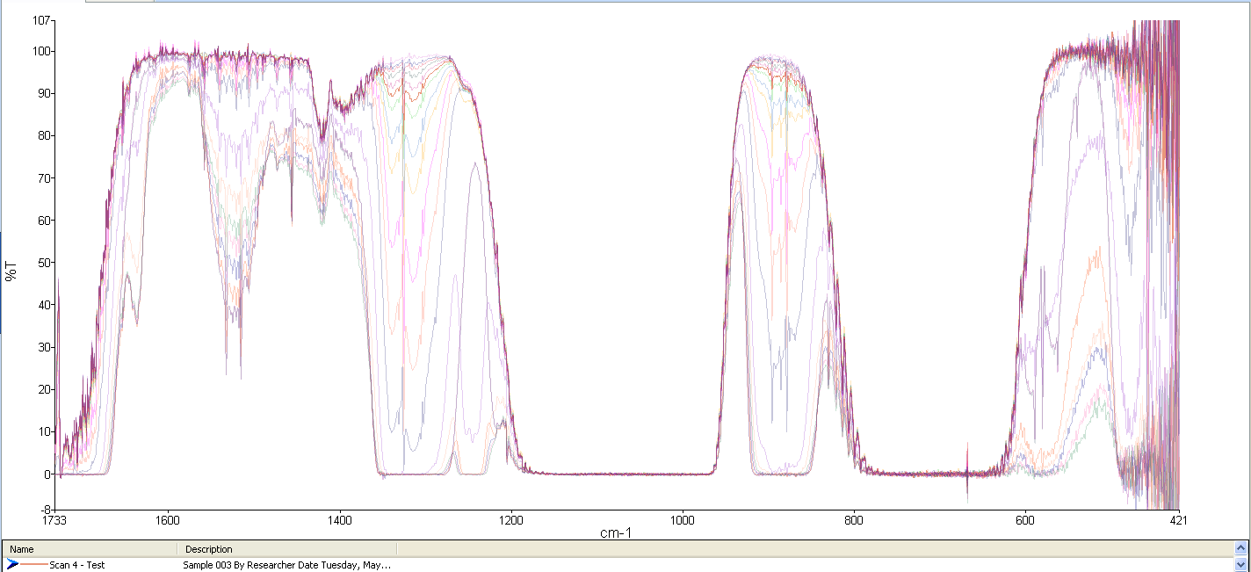
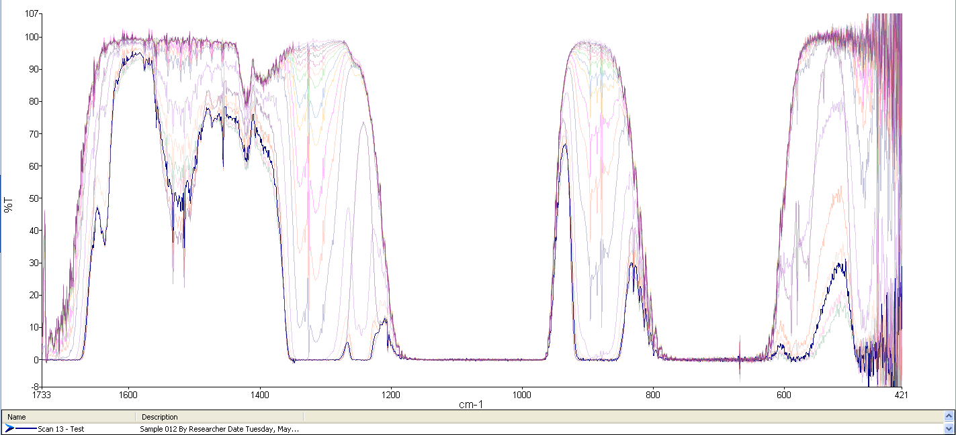
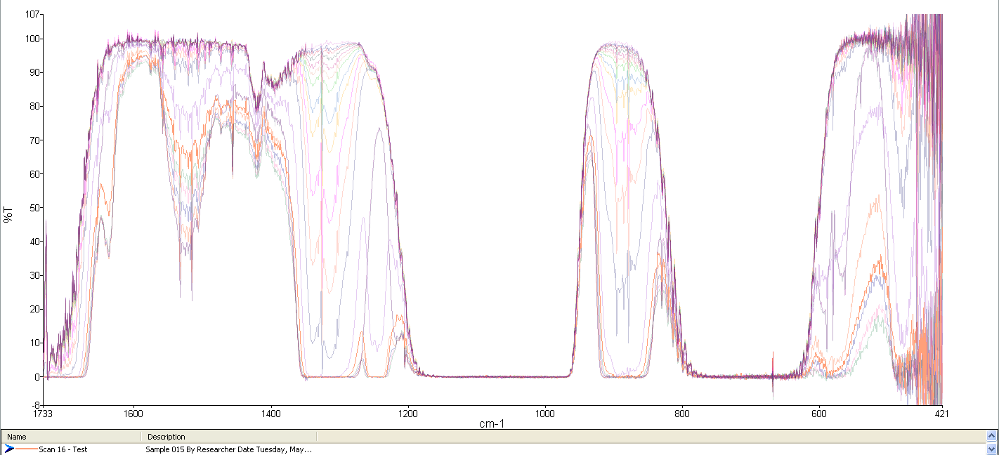
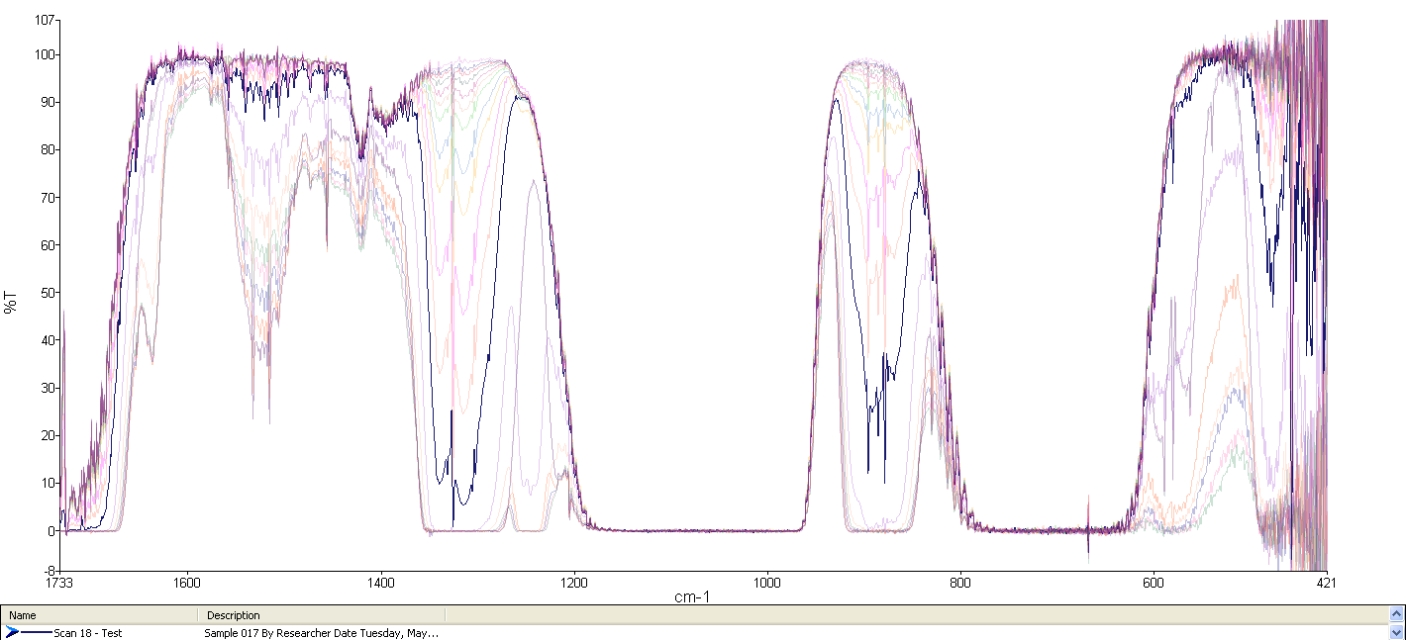
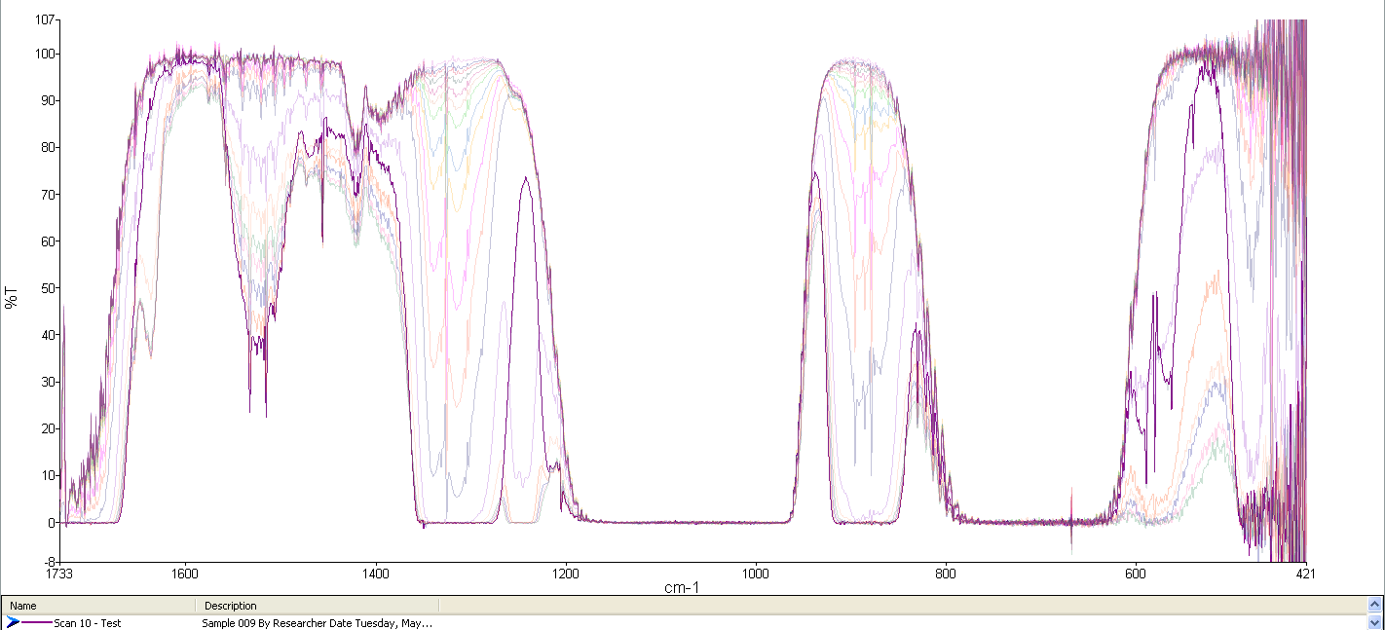
Gas Effluent After N₂ Shutoff

Slide 18
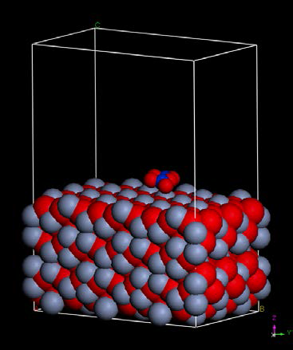
Proposed Study
Calculate the absorption thermodynamics (adsorption equilibria) on steel surfaces (Cr₂O₃, Fe₂O₃) by NOx adsorbates (N₂O, N₂, NO, NO₂, N₂O₅, NO₄).
Model the above results as Langmuir isotherms of physisorbed adsorbates.
Determine the temperature dependence of surface coverage from the equilibrium constants.
Compare the calculated temperature dependencies (and dominate adsorped species) against experimental evidence.
Figure 11. Input schematic of N₂O₅ on Cr₂O₃ surface.

Slide 19
Summary
Nitrogen concentration appears to have a significant impact on gas temperature.
However, the methodology by which the effects of N₂ concentration dictates gas temperature is not clear.
Ozone production (output) also appears to be related to a surface effect on the electrode surfaces.
A deeper investigation into the 3rd-body collisional process and surface chemistry is needed.

Slide 20
References
Koppenol, W. H., Reactions Involving Singlet Oxygen and the Superoxide Anion Nature 1976, 262, 420 421.
Pietscha, G. J.; Gibalov, V. I., Dielectric Barrier Discharges and Ozone Synthesis Pure & Appl. Chem. 1998, 70, 1169-1174.
Murai, A.; Yamabe, C.; Ihara, S., A Study of Ozone Formation on the Surfaces of Electrodes Ozone: Sci Eng. 2010, 32, 153-160.
Lee, H. M.; Chang, M. B.; Wei, T. C., Kinetic Modeling of Ozone Generation Via Dielectric Barrier Discharges Ozone: Sci Eng. 2004, 26, 551-562.
Batakliev, T.; Georgiev, V.; Anachkov, M.; Rakovsky, S.; Zaikov, G. E., Ozone Decomposition Interdisp. Toxicol. 2014, 7, 47-59.
Vosko, S. H.; Wilk, L.; Nusair, M., Accurate Spin-Dependent Electron Liquid Correlation Energies for Local Spin Density Calculations: A Critical Analysis Can. J. Phys. 1980, 58 1200-1211.
Kresse, G.; Hafner, J., Ab Initio Molecular Dynamics for Liquid Metals Phys. Rev. B 1993, 47, 588.
Kresse, G.; Hafner, J., Ab Initio Molecular-Dynamics Simulation of the Liquid-Metal–Amorphous-Semiconductor Transition in Germanium Phys. Rev. B 1994, 49, 14251.
Kresse, G.; Furthmuller, J., Efficiency of Ab-Initio Total Energy Calculations for Metals and Semiconductors Using a Plane-Wave Basis Set Comput. Mat. Sci. 1996, 6, 15-50.
Kresse, G.; Furthmuller, J., Efficient Iterative Schemes for Ab Initio Total-Energy Calculations Using a Plane-Wave Basis Set Phys. Rev. B 1996, 54, 11169

Slide 21
Acknowledgements
Funding Partners:

Slide 23
Appendix
Plasma temperature study – UV emission spectroscopy, Specair analysis, thermocouple tests, & cooling water variation testing. [Slides 10 – 18]
Collisional and radiative processes within a plasma. [Slides 19 – 22]

Slide 24
Collisional and Radiative Processes
The processes that determine the properties of non-thermal plasmas are collisions involving the plasma electrons and other plasma constituents.
The charge carrier production is governed by
Direct ionization of ground state atoms and/or molecules
Step-ionization of an atom/molecule that is already in an excited and, in particular, a long-lived metastable state
The generation of chemically reactive free radicals by electron impact dissociation in molecular plasmas is an important precursor for plasma chemical reactions.

Slide 25
Electron-Atom Collisions
e + A → A^{*/m} + e’ A* → A + hv | Excitation of atoms Spontaneous de-excitation
e + A^{*/m} → A + hv + e’ | Collision-induced de-excitation
e + A → A⁺ + e’ | Ionization of atoms
e + A^{*/m} → A + e’ + E_{kin} | Super-elastic collisions
e + A^{m} → A* + e’ | Step-wise excitation
e + A^{m} → A⁺ + e’ | Step-wise ionization
K. Becker and A. Belkind. ‘Introduction to Plasmas’. Vacuum Technology & Coating (September 2003)

Slide 26
Electron-Molecule Collisions
e + AB → AB^{*/m} + e’ AB* → AB + hv | Excitation of molecules Spontaneous de-excitation
e + AB^{*/m} → AB + hv + e’ | Collision-induced de-excitation
e + AB → A^{*/m} + B + e’ | Dissociation of molecules
e + AB → AB⁺ + e’ | Ionization of molecules
e + AB → A⁺ + B + e’ | Dissociative ionization of molecules
e + AB → A⁺ + B + e’ | Dissociative attachment of molecules
e + A⁺ → A + hv | Radiative recombination of an atomic ion
e + A⁺ + e’ → A + e’ | 3-body dielectronic recombination
e + A⁺ + M → A + M + e’ | 3-body heavy particle recombination
e + AB⁻ → A + B | Dissociative attachment of molecular negative ions
K. Becker and A. Belkind. ‘Introduction to Plasmas’. Vacuum Technology & Coating (September 2003)

Slide 27
Heavy Particle Collisions
A + B⁺ → A⁺ + B | Charge transfer
A + B^{m} → A⁺ + B + e | Penning ionization
A^{m} + A^{m} → A⁺ + A + e | Pair ionization
A* + A → A₂⁺ + e | Hornbeck-Molnar ionization
A⁺ + BC → AC⁺ + B | Ion-molecules reaction
A^{*/m} + BC → AC + B | Chemical reaction
R + BC → RC + B | Chemical reaction with plasma radical, R
K. Becker and A. Belkind. ‘Introduction to Plasmas’. Vacuum Technology & Coating (September 2003)

